Slide 1

Lecturer: Eng. Mahdi Obsiyeh
CCNP
Eelo University
Faculty of IT, TE, BIT
Borama, Somaliland

Slide 2
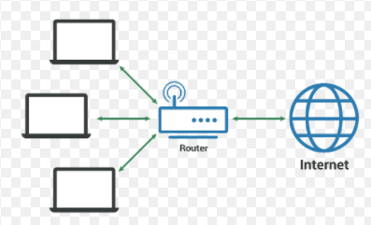
Layer 2 Infrastructure Technologies Chapter 2

Slide 3
INDEX
Network device communication
VLAN and trunking overview
VLAN Trunking Protocol (VTP)
Inter-VLAN Routing
Spanning Tree Protocol Fundamentals
STP Configuration

Slide 4
What are network devices Communication ?
The devices which are used for communication between different hardware’s used in the computer network are known as network devices.
These devices are also known as physical devices, networking hardware, and network equipment otherwise computer networking devices.
In a computer network, each network device plays a key role based on their functionality, and also works for different purposes at different segments.

Slide 5
Network devices, or networking hardware, are physical devices that are required for communication and interaction between hardware on a computer network.
Types of network devices, here is the common network device list:
Hub
Switch
Router
Bridge
Gateway
Repeater
Access Point

Slide 6
Network Hub
The network hub is one kind of networking device in a computer network, used to communicate with various network hosts and also for data transferring.
The transferring of data in a computer network can be done in the form of packets. Whenever the data processing can be done from a host to a network hub, then the data can transmit to all the connected ports. Similarly, all the ports identify the data path which leads to inefficiencies & wastage.
Because of this working, a network hub cannot be so safe and secure

Slide 7
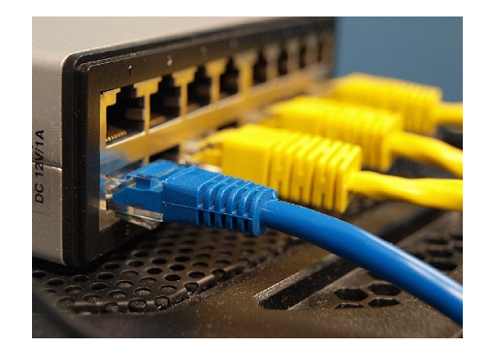
Network Switch
Similar to a hub, this is also working at the layer in the LAN and a switch is more clever compare with a hub. As the hub is used for data transferring, whereas a switch is used for filtering & forwarding the data. So this is the more clever technique to deal with the data packets.

Slide 8
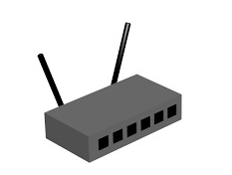
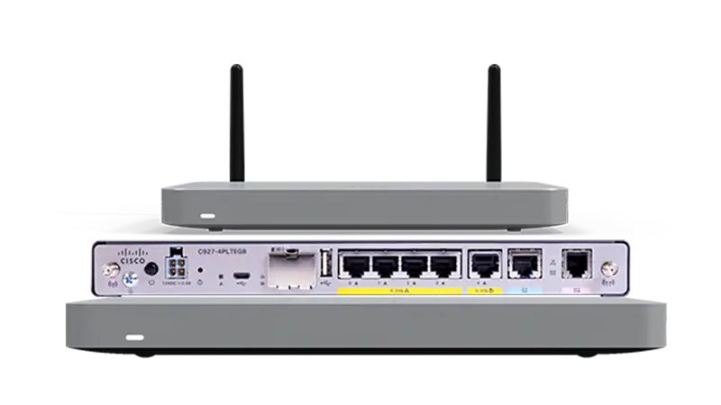
Network Router
A network router is one kind of network device in a computer network and it is used for routing traffic from one network to another. These two networks could be private to a public company network.
For example, here a router is considered as traffic police at the junction, he directs dissimilar traffic networks to dissimilar directions

Slide 9
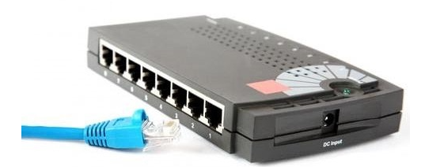
Bridge
A Bridge in the computer network is used to unite two or more network segments. The main function of a bridge in network architecture is to store as well as transmit frames among the various segments. Bridges use MAC (Media Access Control) hardware for transferring frames

Slide 10
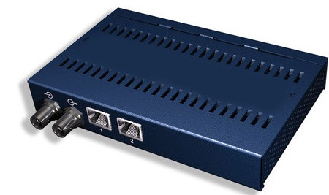
Repeater
The operating of a repeater can be done at the physical layer. The main function of this device is to reproduce the signal on a similar network before the signal gets weak otherwise damaged.
Whenever the signal gets weak, then they reproduce it at the actual strength. A repeater is a two-port device.

Slide 11
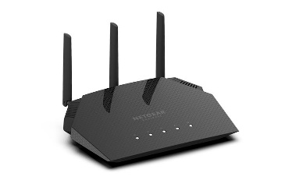

Access Point
While an access point (AP) can technically involve either a wired or wireless connection, it commonly means a wireless device.
An AP works at the second OSI layer, the Data Link layer, and it can operate either as a bridge connecting a standard wired network to wireless devices or as a router passing data transmissions from one access point to another.

Slide 12

Server
In computing, a server is a piece of computer hardware or software (computer program) that provides functionality for other programs or devices, called "clients".
This architecture is called the client–server model. Servers can provide various functionalities,

Slide 13

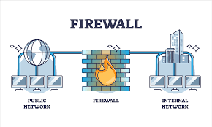
Firewall
A Firewall is a network security device that monitors and filters incoming and outgoing network traffic based on an organization's previously established security policies. At its most basic, a firewall is essentially the barrier that sits between a private internal network and the public Internet.

Slide 14
VLANs and Trunks
Virtual LANs
Consider a network design that consists of Layer 2 devices only. For example, this design could be a single Ethernet segment, an Ethernet switch with many ports, or a network
with several interconnected Ethernet switches. A full Layer 2-only switched network is referred to as a flat network topology .
A flat network is a single broadcast domain, such
that every connected device sees every broadcast packet that is transmitted anywhere in the network. As the number of stations on the network increases, so does the number of
broadcasts.

Slide 15
A VLAN consists of hosts defined as members, communicating as a logical network segment. In contrast, a physical segment consists of devices that must be connected to a physical cable segment.
A VLAN can have connected members located anywhere in the campus network, as long as VLAN connectivity is provided among all members.
Layer 2 switches are configured with a VLAN mapping and provide the logical connectivity among the VLAN members

Slide 16
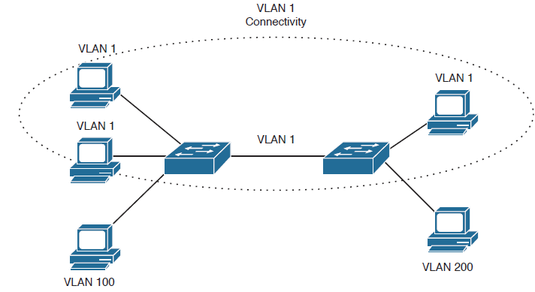
Figure 4-1 shows how a VLAN can provide logical connectivity between switch ports. Two workstations on the left Catalyst switch are assigned to VLAN 1, whereas a third workstation is assigned to VLAN 100. In this example, no communication can occur between VLAN 1 and VLAN 100.

Slide 17
Trunks
VLANs are local to each switch's database, and VLAN information is not passed between switches.
Trunk links provide VLAN identification for frames traveling between switches.
Trunks carry traffic from all VLANs to and from the switch by default but can be configured to carry only specified VLAN traffic.
Trunk links must be configured to allow trunking on each end of the link

Slide 18
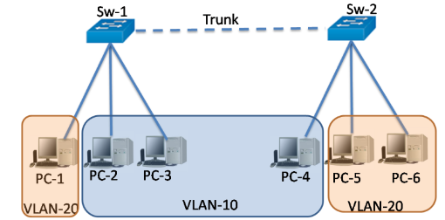

Slide 19
Inter-VLAN routing
Inter-VLAN routing is the ability to route, or send, traffic between VLANs that are normally blocked by default.
Switches and VLANs work at the MAC address Layer (Layer 2).
Traffic can’t be routed between VLANs at Layer 2 based on MAC addresses. Therefore, Routers or (Layer 3 switches) that use IP addresses (Layer 3) are required for inter-VLAN routing.

Slide 20
How to Route Between VLANs
There are two main ways to accomplish inter-VLAN routing: the router on a stick model or Layer 3 switch inter-VLAN routing.
Generally, a Layer 3 switch will have better performance and less latency than the router on a stick. This is because the routing is handled in hardware instead of software with the Layer 3 switch vs. the Router.
The inter-VLAN routing method chosen will largely depend on what hardware is available to the network administrator on the given network, so it is important to understand both concepts.

Slide 21
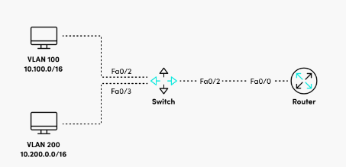
How to configure router on a stick inter-VLAN Routing
We’ll use the router on a stick model for our first example. In this model, switches with multiple VLANs uplink to a single router. Although there is one physical uplink, the router uses virtual sub-interfaces. One sub-interface per VLAN is used and the router is configured to route traffic between the VLANs.

Slide 22
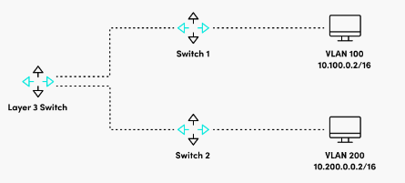
How to configure inter-VLAN routing with a Layer 3 switch
In addition to forwarding based on Layer 2 MAC addresses, Layer 3 switches can forward traffic based on IP address. Layer 3 switches introduce the ability to create Switch Virtual Interfaces (SVIs). SVIs are logical Layer 3 interfaces that allow the forwarding of traffic based on Layer 3 IP addresses.

Slide 23
VTP “Virtual Trunking Protocol “
VTP allows a network manager to configure a switch so that it will propagate VLAN configurations to other switches in the network.
The switch can be configured in the role of a VTP server or a VTP client.
VTP only learns about normal-range VLANs (VLAN IDs 1 to 1005). • Extended-range VLANs (IDs greater than 1005) are not supported by VTP.
VTP stores VLAN configurations in the VLAN database called vlan.dat.

Slide 24
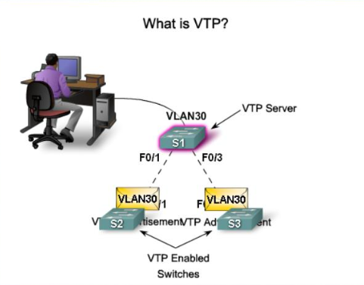

Slide 25
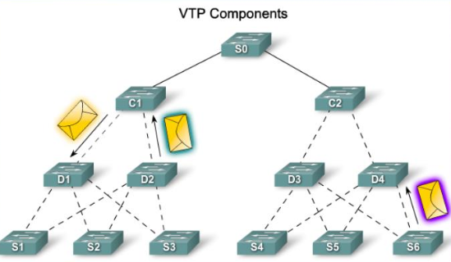
VTP Components (1)
VTP Advertisements - VTP uses a hierarchy of advertisements to distribute and synchronize VLAN configurations across the network.

Slide 26
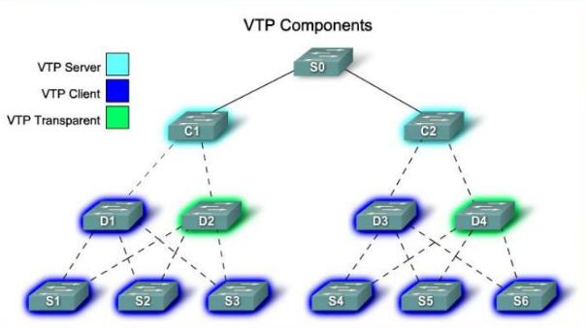
VTP Components (2)
VTP Modes - A switch can be configured in one of three modes: server, client, or transparent.

Slide 27
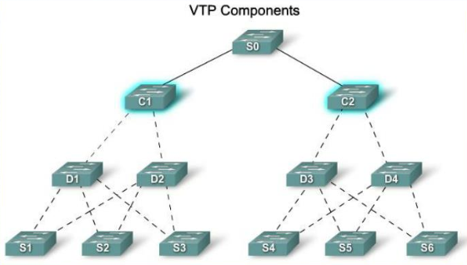
VTP Components (3)
VTP Server - VTP servers advertise the VTP domain VLAN information to other VTP-enabled switches in the same VTP domain.
VTP servers store the VLAN information for the entire domain in NVRAM.
The server is where VLAN can created, deleted, or renamed for the domain.

Slide 28
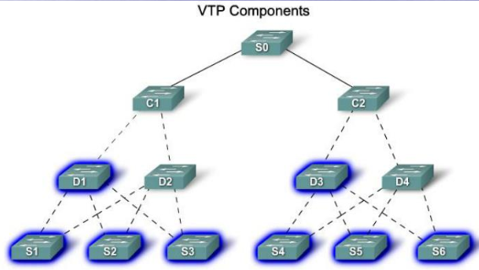
VTP Components (4)
VTP Client - VTP clients function the same way as VTP servers, but you cannot create, change, or delete VLANs on a VTP client.
A VTP client only stores the VLAN information for the entire domain while the switch is on.
You must configure VTP client mode on a switch.

Slide 29
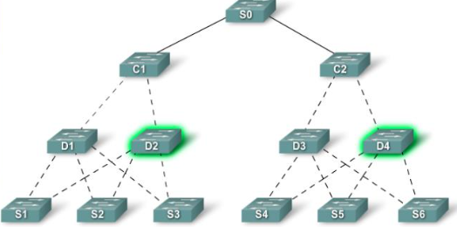
VTP Components (5)
VTP Transparent - Transparent switches forward VTP advertisements to VTP clients and VTP servers.
Transparent switches do not participate in VTP.

Slide 30
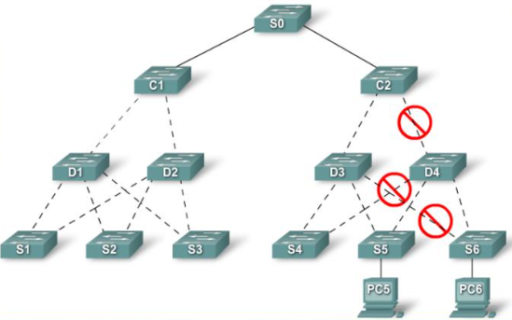
VTP Components (6)
VTP Pruning-VTP pruning increases network available bandwidth by restricting flooded traffic to those trunk links that the traffic must use to reach the destination devices

Slide 31
Switching Loop
When there is more than one path between two switches
What are the potential problems?
Switch A
Switch B
Swtich C

Slide 32
Switching Loop
Switch A
Switch B
Node1 sends a broadcast frame (e.g. an ARP request)
Swtich C
Node 1

Slide 33
Switching Loop
Switches A, B and C broadcast node 1’s frame out every port
Switch A
Switch B
Swtich C
Node 1

Slide 34
Switching Loop
But they receive each other’s broadcasts, which they need to forward again out every port!
The broadcasts are amplified, creating a broadcast storm
Switch A
Switch B
Swtich C
Node 1

Slide 35
Introduction to Spanning-Tree
Previous slides covered ways to connect two switches together with a VLAN, Trunk link and VTP
Spanning Tree Protocol (STP) was designed to monitor and control the Layer 2 network so that a loop-free topology
is maintained
Spanning-tree is a protocol that runs on our switches that helps us to solve loops. Spanning-tree is one of the protocols that you must understand as a network engineer.
This lesson is an introduction to spanning-tree, you will learn why we need it, how it works and how you can check the spanning-tree topology on your Cisco switches.

Slide 36
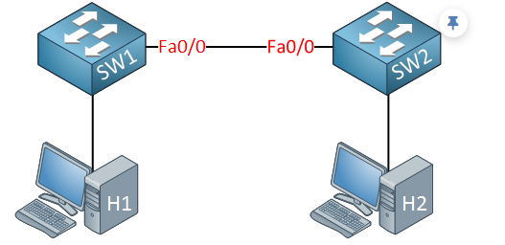
Introduction to Spanning-Tree
What is a loop, and how do we get one? Let me show you an example:
In the picture above, we have two switches. These switches are connected with a single cable, so there is a single point of failure.

Slide 37
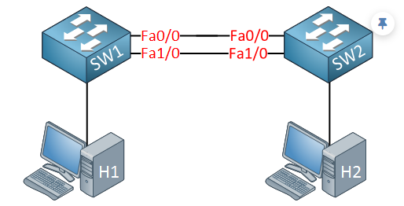
To get rid of this single point of failure, we will add another cable:

Slide 38
With the extra cable, we now have redundancy. Unfortunately for us, redundancy also brings loops. Why do we have a loop in the scenario above? Let me describe it to you:
H1 sends an ARP request because it’s looking for the MAC address of H2. An ARP request is a broadcast frame.
SW1 will forward this broadcast frame on all it interfaces, except the interface where it received the frame on.
SW2 will receive both broadcast frames.

Slide 39
Now, what does SW2 do with those broadcast frames?
It will forward it from every interface except the interface where it received the frame.
This means that the frame that was received on interface Fa0/0 will be forwarded on Interface Fa1/0.
The frame that was received on Interface Fa1/0 will be forwarded on Interface Fa0/0.
Do you see where this is going? We have a loop! Both switches will keep forwarding over and over again until the following happens:
You fix the loop by disconnecting one of the cables.

Slide 40
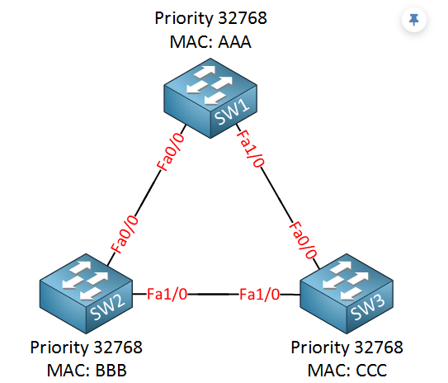
How spanning-tree solves loops
Spanning-tree will help us to create a loop-free topology by blocking certain interfaces. Let’s take a look at how spanning-tree work! Here’s an example:

Slide 41
We have three switches, and as you can see, we have added redundancy by connecting the switches in a triangle, this also means we have a loop here. I have added the MAC addresses but simplified them for this example:
SW1: MAC AAA
SW2: MAC BBB
SW3: MAC CCC

Slide 42
Since spanning-tree is enabled, all our switches will send a special frame to each other called a BPDU (Bridge Protocol Data Unit). In this BPDU, there are two pieces of information that spanning-tree requires:
MAC address
Priority

Slide 43
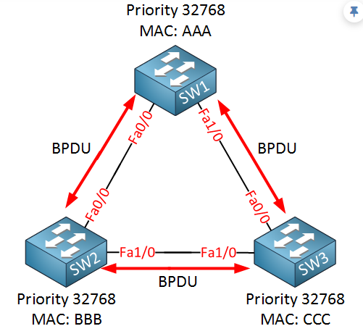
The MAC address and the priority together make up the bridge ID. The BPDU is sent between switches as shown in the following picture:

Slide 44
Spanning-tree requires the bridge ID for its calculation. Let me explain how it works:
First of all, spanning-tree will elect a root bridge; this root bridge will be the one that has the best “bridge ID”.
The switch with the lowest bridge ID is the best one.
By default, the priority is 32768, but we can change this value if we want.
So who will become the root bridge? In our example, SW1 will become the root bridge! Priority and MAC address make up the bridge ID. Since the priority is the same on all switches, it will be the MAC address that is the tiebreaker. SW1 has the lowest MAC address thus the best bridge ID and will become the root bridge.

Slide 45
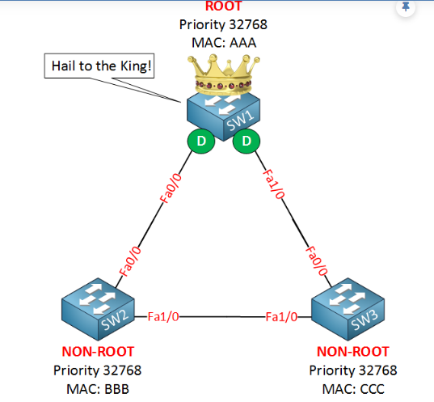
The ports on our root bridge are always designated, which means they are in a forwarding state. Take a look at the following picture:
Above, you see that SW1 has been elected as the root bridge and the “D” on the interfaces stands for designated.

Slide 46
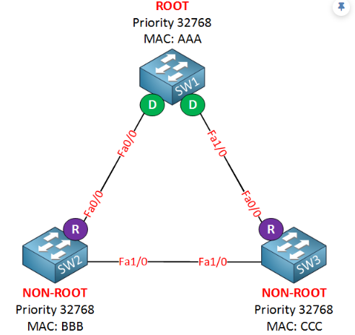
Our next step for all our “non-root” bridges (so that’s every switch that is not the root) will have to find the shortest path to our root bridge! The shortest path to the root bridge is called the “root port”. Take a look at my example:
I’ve put an “R” for “root port” on SW2 and SW3. Their Fa0/0 interface is the shortest path to get to the root bridge

Slide 47
In my example, I’ve kept things simple, but “shortest path” in spanning-tree means it will actually look at the speed of the interface. Each interface has a certain cost, and the path with the lowest cost will be used. Here’s an overview of the interfaces and their cost:
10 Mbit = Cost 100
100 Mbit = Cost 19
1000 Mbit = Cost 4

Slide 48
Excellent!…we have designated ports on our root bridge and root ports on our non-root bridges, we still have a loop, however, so we need to shut down a port between SW2 and SW3 to break that loop. So which port are we going to shut down? The one on SW2 or the one on SW3? We’ll look again at the best bridge ID:
Bridge ID = Priority + MAC address.
Lower is better, both switches have the same priority, but the MAC address of SW2 is lower, which means that SW2 will “win this battle”. SW3 is our loser here which means it will have to block its port, effectively breaking our loop! Take a look at my example:

Slide 49
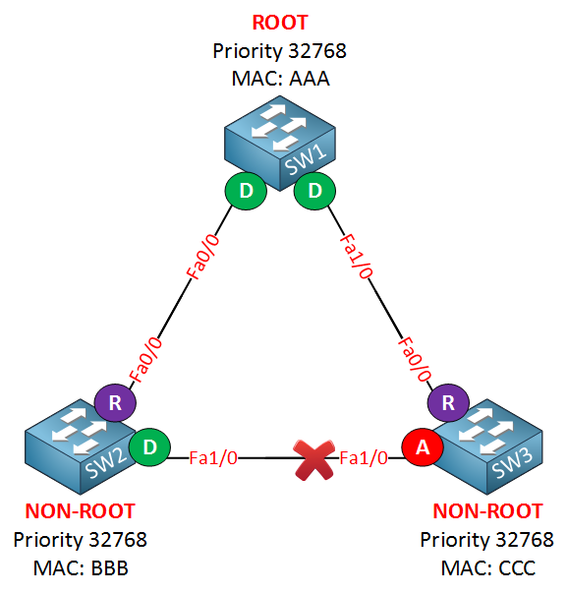
If you look at the link between SW2 and SW3, you can see that the Fa1/0 interface of SW3 says “A” which stands for alternate. An alternate port is blocked! Sometimes the alternate port is called the ND (Non Designated) port. By shutting down this interface, we have solved our loop problem.

Slide 50
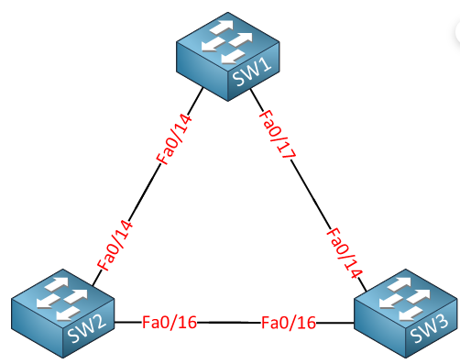
Spanning-tree configuration on Cisco switches
Now you have an idea what spanning-tree is about. Let’s take a look at some Cisco switches to see how we can configure them. I will use the same topology that I showed you earlier, but we have different interfaces.
This is the topology we will use. Spanning-tree is enabled by default; let’s start by checking some show commands

Slide 51
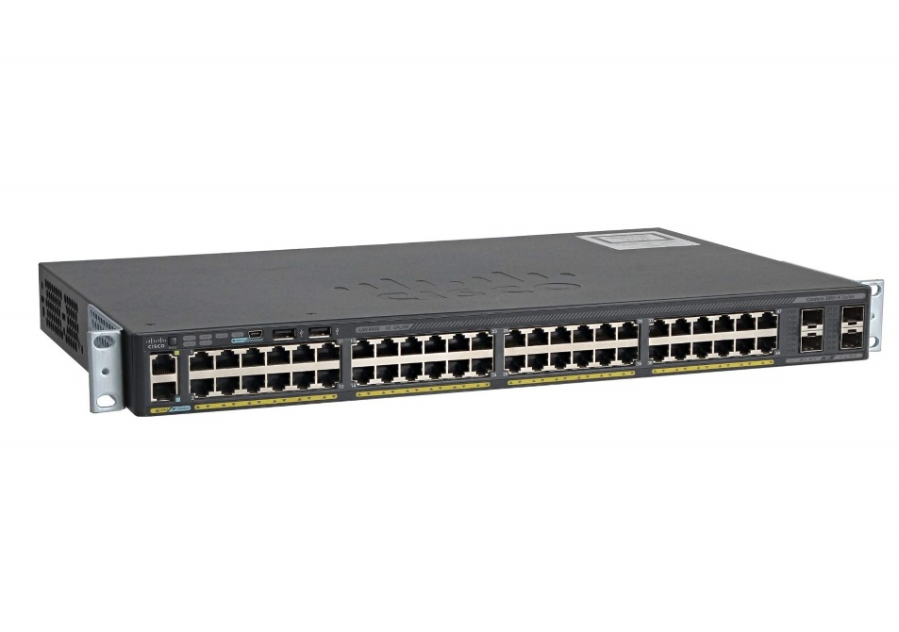
Port fast
Portfast is a Cisco technique that puts a switch interface into forwarding mode immediately, skipping the listening and learning states. This is useful for interfaces that connect to computers or servers so that these devices don’t have to wait until the interface is up and running

Slide 52
END

